Slide 1



ANALYSIS OF
acquiring
5/18/2023

Slide 2

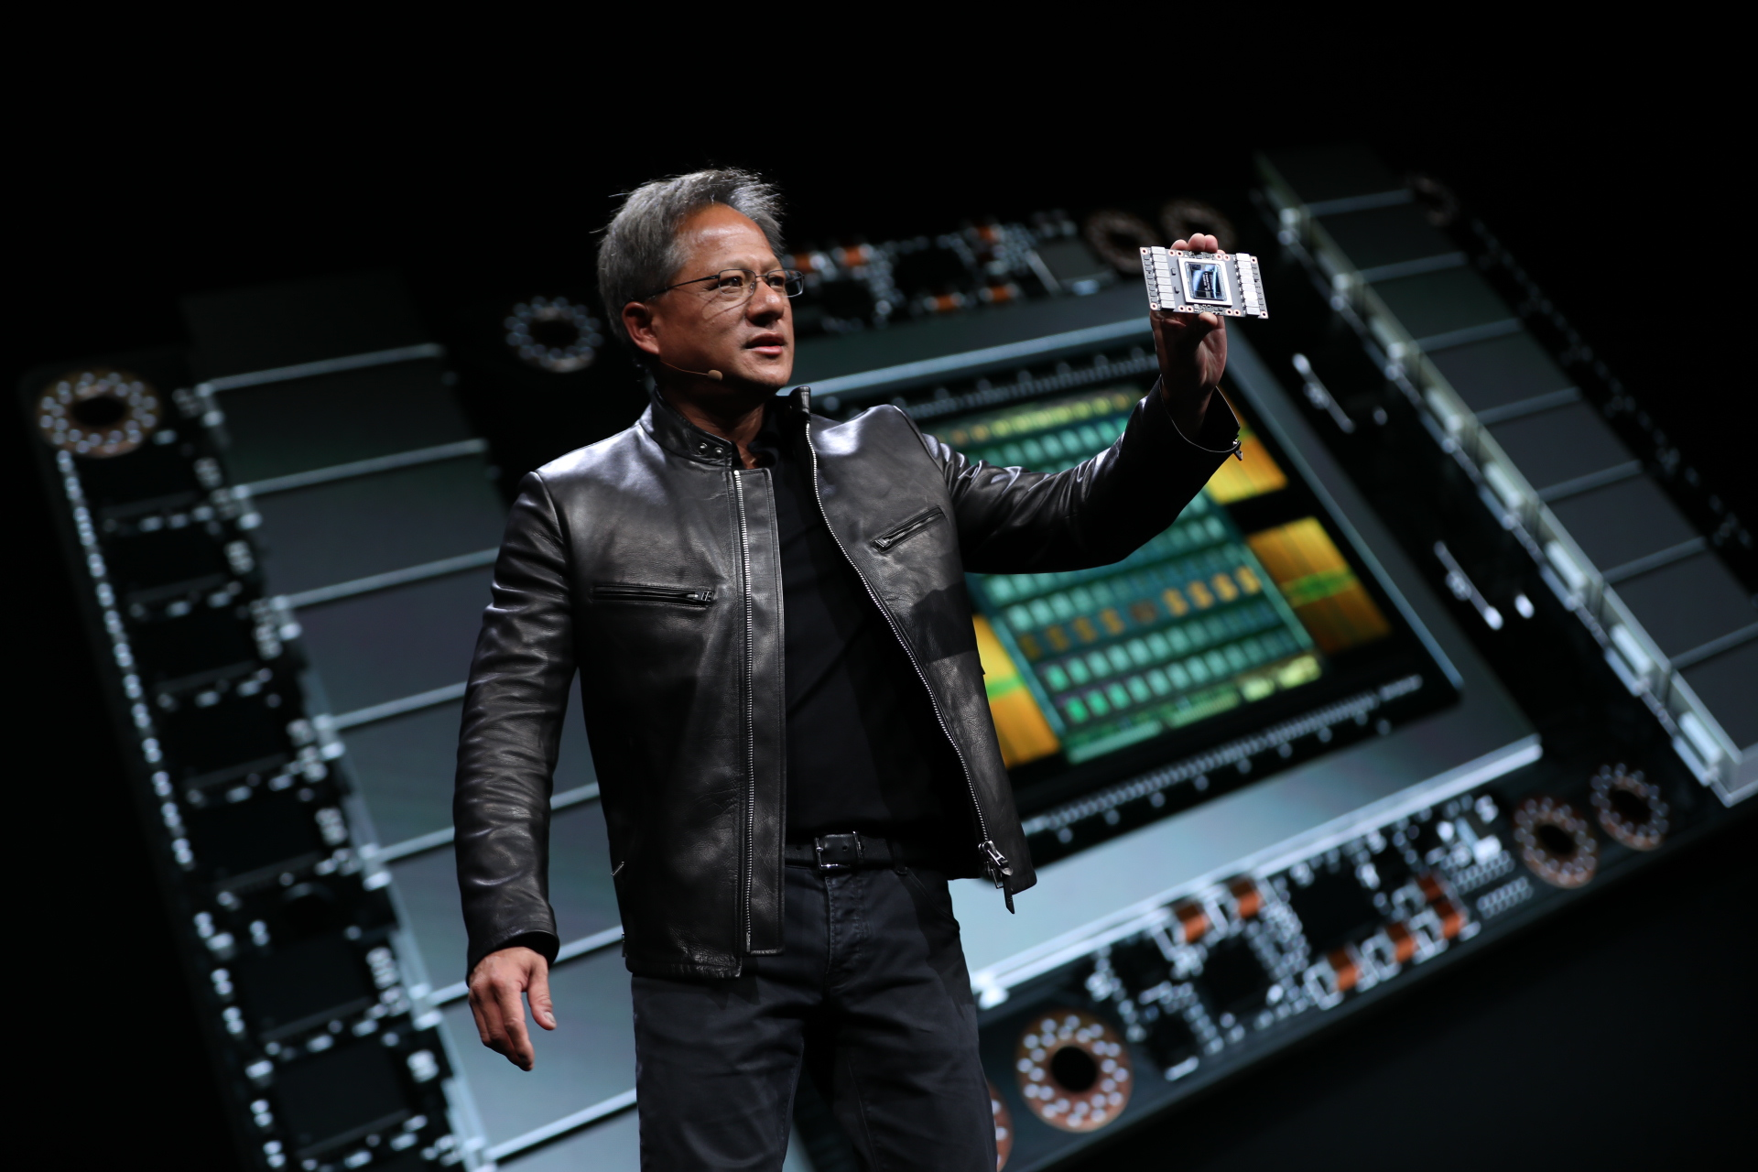


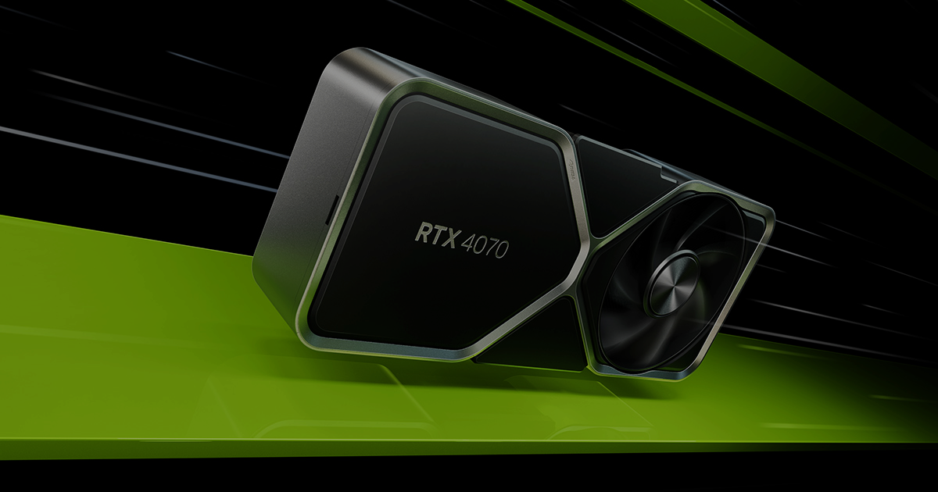
INTRODUCTION
Team Member
Senior Analyst: Peng Liu
Senior Analyst: Chengyi Xu
Intern Analyst: Zanglong Xuan
CEO: Jensen Huang
Source: SEC, Refinitiv, Capital IQ, Annual Reports, Yahoo Finance, Market Watch Units: 1 USD 1

Slide 3
EXECUTIVE SUMMARY
Industry and Company Overview
Target Valuation with different methods
Combination Analysis
Conclusion and Decision
Source: SEC, Refinitiv, Capital IQ, Annual Reports, Yahoo Finance, Market Watch Units: 1 USD 1

Slide 4


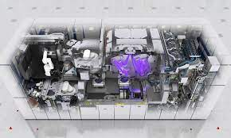

Strategic Alignment: NVIDIA & ASML Synergies
How the Acquisition Creates Long-term Value
Strategic Rationale:
ASML: EUV lithography and OLIGOPOLY in the market
Nvidia: AI boom and diverse GPU applications
Benefits of Acquisition:
Suppress COMPETITION (Intel)
Lower production COSTS
Enhanced innovation POTENTIAL (CULitho)
Access to ASML's strong intellectual property and patent portfolio
The complementary nature of their businesses can result in COST SAVINGS, REVENUE GROWTH, and INCREASED INNOVATION POTENTIAL.
Source: SEC, Refinitiv, Capital IQ, Annual Reports, Yahoo Finance, Market Watch Units: 1 USD 2

Slide 5



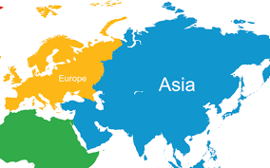

SWOT
STRENGTHS
WEAKNESS
OPPORTUNITY
THREATS
Strategic Strong financial statement
Higher GM than industry
Technology lead over peers & market leader in lithography systems
Globalized market
High R&D costs
Ambitionless
Low current ratio
culture
High reliance on certain product
Innovation (major drivers)
5G connectivity, Artificial intelligence, Autonomous driving, big data
Growing demand for semiconductors
Chip shortage - memory& logic
Develop new lithography technology
Macro Events
Slow Growth, low adoption
Geopolitical tension
Semiconductor industries are highly competitive
R: 14%
GM:
10.5%
Source: SEC, Refinitiv, Capital IQ, Annual Reports, Yahoo Finance, Market Watch Units: 1 USD 3

Slide 6
Acquisition Opportunity: Factors Influencing ASML's Availability
Exploring Potential Catalysts for a Successful Deal
Increasing access to Chinese market
Ambitious CEO
Consolidation of industry leadership positions in both GPU and semiconductor equipment markets
Need for more talented semiconductor engineers and supply chain management.
Enters a new field of gaming industry, push for innovation, diversification of sales
Enhanced bargaining power
Source: SEC, Refinitiv, Capital IQ, Annual Reports, Yahoo Finance, Market Watch Units: 1 USD 4

Slide 7
STANDALONE VALUATION
Conclusions
545.00, Concluded Price
Market Prices
Weighted Prices
Comparable Trading
Earnings Cap
FCFE
FCFF
Source: SEC, Refinitiv, Capital IQ, Annual Reports, Yahoo Finance, Market Watch. Units: 1 USD 5

Slide 8
STANDALONE VALUATION
Conclusions
 | Base Case | Worst Case | Best Case | Weight
Income Approach
FCFF | 564.23 | 465.73 | 750.60 | 25%
FCFE | 596.84 | 496.37 | 782.13 | 25%
Dividend Discount Model | 157.26 | 128.94 | 201.51 | 0%
Earnings Capitalization | 493.94 | 398.93 | 546.52 | 10%
Market Approach
Comparable Trading | 513.34 | 484.71 | 542.78 | 40%
Weighted Value per Share | 545.00 | 474.30 | 654.95
Source: SEC, Refinitiv, Capital IQ, Annual Reports, Yahoo Finance, Market Watch Units: 1 USD 6

Slide 9
STANDALONE VALUATION: assumptions
WACC
Other Assumptions
Risk Free: 20 Y T-bond | 3.88%
Beta 5Y: Capital IQ | 1.25
Implied Premium: Damodaran | 5.11%
Dividend Growth | 5.95%
CONCLUSIONS
Market Prices
Items | Book Value | Weightings | After-Tax Cost | WACC
Debt | 4,260 | 2% | 2.77% | 0.06%
Equity | 206,811 | 98% | 9.97% | 9.77%
Capital |  |  |  | 9.82%
Weighted Prices
Cost of Debt
Cost of Equity
Coupon | Price | YTM | Years to maturity | Weight | Weighted YTM
3.38 | 99.92 | 3.5% | 1 | 3.23% | 0.11%
1.38 | 94.44 | 3.4% | 3 | 9.68% | 0.32%
1.63 | 93.83 | 3.3% | 4 | 12.90% | 0.43%
0.63 | 85.31 | 3.4% | 6 | 19.35% | 0.65%
0.25 | 81.47 | 3.3% | 7 | 22.58% | 0.73%
2.25 | 92.65 | 3.1% | 10 | 32.26% | 1.01%
Concluded |  |  |  |  | 3.254%
Earnings Cap
MODELS | Values | Weights
DDM | 7.26% | 10%
Earnings Cap | 3.30% | 0%
CAPM | 10.27% | 90%
Concluded | 9.97% | 100%
FCFE
FCFF
Source: SEC, Refinitiv, Capital IQ, Annual Reports, Yahoo Finance, Market Watch Units: Millions OR 1EURO 7

Slide 10



STANDALONE VALUATION: assumptions
Terminal Growth
Dollar Value
Revenue Region | 2022 Revenue | Weights | GDP Growth | Inflation | R&D Discounted | Weighted Total
Japan | 1,008.6 | 5% | 2% | 2% | 1% | 0.23%
South Korea | 6,045.6 | 29% | 0% | 0% | 0% | 0.03%
Singapore | 475.5 | 2% | 3% | 1% | 1% | 0.11%
China | 11,018.7 | 52% | 4% | 4% | 2% | 5.07%
Netherlands | 9.2 | 0% | 1% | 2% | 0% | 0.00%
Rest of the World | 624.5 | 3% | 1% | 4% | 1% | 0.18%
United States | 1,991.3 | 9% | 1% | 2% | 0% | 0.33%
Total | 21,173.4 | 100% |  |  |  | 5.95%
Earnings Cap
Product
Upgrade
FCFE
FCFF
Purchasing Power
Source: SEC, Refinitiv, Capital IQ, Annual Reports, Yahoo Finance, Market Watch. Units: Millions EURO 8

Slide 11
STANDALONE VALUATION: assumptions
Other Key Assumptions
Assumptions | Methodologies | Values
Net System Sales | Average Growth | 17%
Net Service and field option sales | Average Growth | 22%
COGS respectively | Average % of respective segment | 50%
Research and development costs | Average % of Sales | 15%
SG & A | Average % of Sales | 4%
Other income | Average % of Sales | 1%
Interest and other, net | Average % of EBIT | 1%
Income tax | Average % of Income before income taxes | 13%
PPE | Average Growth | 26%
D&A | Average % of PPE | 15%
CapEx | Average % of Net income | 23%
Net Working Capital | Average % of Net Sales | 33%
Earnings Cap
FCFE
FCFF
Source: SEC, Refinitiv, Capital IQ, Annual Reports, Yahoo Finance, Market Watch. 9

Slide 12






STANDALONE VALUATION: assumptions
Best & Worst Cases
METRICS | CURRENT VALUES | BEST | WORST
WACC | 9.82% | 8.49% | 11.44%
Cost of Equity | 9.97% | 8.37% | 11.28%
Terminal Growth | 6.0% | 6.83% | 5.07%
Market Prices
Weighted Prices
FCFE
FCFF
Source: SEC, Refinitiv, Capital IQ, Annual Reports, Yahoo Finance, Market Watch. 10

Slide 13
STANDALONE VALUATION: models
DCF Conclusions
 | FCFE | FCFF
XNPV | 218,633 | 210,552
Plus, Cash on Balance Sheet | 7,268 | 7,268
Enterprise Value |  | 217,821
Less Debt |  | 4,260
Equity Value | 225,902 | 213,560
Shares | 398 | 398
Value Per Share (Base Case) | 567.59 | 536.58
Value Per Share (Worst Case) | 472.05 | 442.91
Value Per Share (Best Case) | 743.81 | 713.82
 |  | Cost of Equity
FCFE | 567.59 | 11.44% | 11.07% | 10.71% | 10.34% | 9.97% | 9.60% | 9.23% | 8.86% | 8.49%
Terminal Growth | 5.07% | 374.83 | 386.45 | 414.11 | 445.85 | 480.21 | 517.33 | 557.54 | 601.27 | 649.02
 | 5.29% | 402.48 | 404.47 | 433.79 | 469.13 | 507.89 | 550.21 | 596.62 | 647.74 | 704.36
 | 5.51% | 411.74 | 413.83 | 444.81 | 482.33 | 523.71 | 569.19 | 619.39 | 675.12 | 737.35
 | 5.73% | 423.36 | 425.59 | 458.72 | 499.09 | 543.95 | 593.63 | 648.97 | 711.00 | 781.03
 | 6.0% | 436.65 | 439.04 | 474.73 | 518.52 | 567.59 | 622.45 | 684.20 | 754.22 | 834.34
 | 6.17% | 452.08 | 454.67 | 493.46 | 541.46 | 595.78 | 657.19 | 727.18 | 807.70 | 901.35
 | 6.39% | 470.23 | 473.06 | 515.67 | 568.95 | 629.95 | 699.85 | 780.76 | 875.51 | 988.04
 | 6.61% | 491.86 | 495.00 | 542.44 | 602.47 | 672.21 | 753.48 | 849.39 | 964.31 | 1104.57
 | 6.83% | 518.08 | 521.60 | 575.29 | 644.25 | 725.81 | 822.90 | 940.40 | 1085.56 | 1269.49
 |  | Cost of Capital
FCFF | 536.58 | 11.28% | 10.91% | 10.55% | 10.19% | 9.82% | 9.46% | 9.09% | 8.73% | 8.37%
Terminal Growth | 5.07% | 347.70 | 358.90 | 385.60 | 416.31 | 449.62 | 485.68 | 524.86 | 567.59 | 614.39
 | 5.29% | 374.69 | 376.61 | 405.01 | 439.31 | 477.03 | 518.35 | 563.80 | 614.04 | 669.91
 | 5.51% | 383.82 | 385.85 | 415.91 | 452.40 | 492.77 | 537.27 | 586.59 | 641.54 | 703.19
 | 5.73% | 395.31 | 397.48 | 429.69 | 469.05 | 512.93 | 561.72 | 616.29 | 677.74 | 747.49
 | 6.0% | 408.47 | 410.80 | 445.58 | 488.41 | 536.58 | 590.67 | 651.84 | 721.59 | 801.89
 | 6.17% | 423.80 | 426.33 | 464.24 | 511.35 | 564.89 | 625.72 | 695.45 | 776.18 | 870.80
 | 6.39% | 441.87 | 444.65 | 486.46 | 538.95 | 599.37 | 669.02 | 750.18 | 846.00 | 960.88
 | 6.61% | 463.50 | 466.58 | 513.32 | 572.78 | 642.27 | 723.83 | 820.90 | 938.41 | 1083.59
 | 6.83% | 489.82 | 493.30 | 546.48 | 615.19 | 697.09 | 795.45 | 915.78 | 1066.43 | 1260.55
Market Prices
Weighted Prices
Earnings Cap
FCFE
FCFF
Source: SEC, Refinitiv, Capital IQ, Annual Reports, Yahoo Finance, Market Watch. Units: Millions or 1 EURO 11

Slide 14
STANDALONE VALUATION: models
DCF Calculations
Free Cash Flows to Equity (FCFE) (“Direct Equity” method)
Years | 12/31/23 | 12/31/24 | 12/31/25 | 12/31/26 | 12/31/27
Operating Income | 7,764.57 | 9,194.48 | 10,890.56 | 12,902.92 | 15,291.22
- Taxes | (976.75) | (1,156.63) | (1,369.99) | (1,623.14) | (1,923.58)
Earnings Available to Common | 6,787.82 | 8,037.85 | 9,520.57 | 11,279.78 | 13,367.64
+ Depreciation & Amortization | 757.52 | 951.28 | 1194.62 | 1500.20 | 1883.94
- Capital Expenditures | (1,596.34) | (1,890.32) | (2,239.03) | (2,652.76) | (3,143.78)
+/- Change in net working capital | 1,461.45 | (1,523.25) | (1,807.06) | (2,144.35) | (2,545.33)
- Principal repayments | 753.80 | 2.00 | 2.00 | 1,002.00 | 752.00
+ New debt issued | - | - | - | - | -
= FCFE | 8,164.25 | 5,577.56 | 6,671.10 | 8,984.87 | 10,314.47
Market Prices
Weighted Prices
Earnings Cap
Free Cash Flows to the Firm (FCFF) (“Invested Capital” method)
EBIT | 7,764.57 | 9,194.48 | 10,890.56 | 12,902.92 | 15,291.22
+ Depreciation & Amortization | 757.52 | 951.28 | 1194.62 | 1500.20 | 1883.94
EBITDA | 8522.09 | 10145.77 | 12085.18 | 14403.11 | 17175.16
- Cash Paid for Taxes | (976.75) | (1,156.63) | (1,369.99) | (1,623.14) | (1,923.58)
- Capital Expenditures | (1,596.34) | (1,890.32) | (2,239.03) | (2,652.76) | (3,143.78)
+/- Change in net working capital | 1,461.45 | (1,523.25) | (1,807.06) | (2,144.35) | (2,545.33)
=FCFF | 7410.45 | 5575.56 | 6669.10 | 7982.87 | 9562.47
FCFE
FCFF
Source: SEC, Refinitiv, Capital IQ, Annual Reports, Yahoo Finance, Market Watch. Units: Millions or 1 EURO 12

Slide 15



STANDALONE VALUATION: models
Comparable Trading
Logic | Upper Bound | Upper Bound | Maximum | Upper Bound | Upper Bound | Upper Bound
Metrics | Price/EPS | EV/Revenue | EV/EBIT | EV/EBITDA | Price/Book | Price/Revenue
Selected | 38.71 | 10.048 | 27.57 | 28.615 | 20.57 | 11.20
Implied TEV Range |  | 212,596.72 | 179,196.51 | 202,660.93
Less Net Debt |  | -3,007.9 | -3,007.9 | -3,007.9
Equity Value |  | 209,588.82 | 176,188.61 | 199,653.03
Implied Per Share Price | 547.05 | 527.00 | 443.02 | 502.02 | 300.07 | 596.23
Weighting (Base Case) | 20% | 13% | 20% | 20% | 13% | 13%
Weighting (Worst Case) | 30% | 10% | 10% | 10% | 30% | 10%
Weighting (Best Case) | 10% | 30% | 10% | 10% | 10% | 30%
Final Implied Share Price (Base) | 488.19
Final Implied Share Price (Worst) | 460.96
Final Implied Share Price (Best) | 516.18
Market Prices
Weighted Prices
Earnings Cap
FCFE
FCFF
Source: SEC, Refinitiv, Capital IQ, Annual Reports, Yahoo Finance, Market Watch. Units: Millions or 1 EURO 13

Slide 16





SYNERGIES VALUATION
Assumptions
Order Cost Reduction
R&D Expense Reduction
Metrics | Values | Interval for Sensitivity | Best | Worst
R&D Expense Reduction Percentages | 5% | 1.25% | 10% | 0%
Order Costs Reduction Percentages | 5% | 1.25% | 10% | 0%
Source: SEC, Refinitiv, Capital IQ, Annual Reports, Yahoo Finance, Market Watch. 14

Slide 17
SYNERGIES VALUATION
Conclusion
 |  | Cost of Equity
FCFE | 686.58 | 11.44% | 11.07% | 10.71% | 10.34% | 9.97% | 9.60% | 9.23% | 8.86% | 8.49%
Terminal Growth | 5.07% | 549.09 | 552.65 | 560.40 | 568.18 | 575.51 | 582.39 | 588.86 | 594.97 | 600.73
 | 5.29% | 585.86 | 586.44 | 594.34 | 602.62 | 610.46 | 617.81 | 624.73 | 631.25 | 637.42
 | 5.51% | 605.04 | 605.64 | 613.83 | 622.42 | 630.54 | 638.17 | 645.34 | 652.11 | 658.50
 | 5.73% | 629.65 | 630.27 | 638.84 | 647.83 | 656.32 | 664.29 | 671.80 | 678.87 | 685.56
 | 6.0% | 658.54 | 659.20 | 668.21 | 677.65 | 686.58 | 694.97 | 702.86 | 710.30 | 717.33
 | 6.17% | 693.19 | 693.88 | 703.42 | 713.42 | 722.87 | 731.75 | 740.10 | 747.98 | 755.41
 | 6.39% | 735.47 | 736.20 | 746.38 | 757.06 | 767.15 | 776.63 | 785.55 | 793.96 | 801.90
 | 6.61% | 788.20 | 788.99 | 799.98 | 811.50 | 822.39 | 832.61 | 842.23 | 851.31 | 859.88
 | 6.83% | 855.79 | 856.66 | 868.67 | 881.27 | 893.18 | 904.37 | 914.89 | 924.81 | 934.19
 |  | R&D Expense Reduction Percentages
FCFE | 686.58 | 0.00% | 1.25% | 2.50% | 3.75% | 5.00% | 6.25% | 7.50% | 8.75% | 10.00%
Order Costs Reduction Percentages | 0.00% | 591.64 | 600.01 | 608.37 | 616.74 | 625.11 | 633.48 | 641.85 | 650.21 | 658.58
 | 1.25% | 598.64 | 615.37 | 623.74 | 632.11 | 640.48 | 648.85 | 657.21 | 665.58 | 673.95
 | 2.50% | 614.01 | 630.74 | 639.11 | 647.48 | 655.85 | 664.21 | 672.58 | 680.95 | 689.32
 | 3.75% | 629.37 | 646.11 | 654.48 | 662.85 | 671.21 | 679.58 | 687.95 | 696.32 | 704.69
 | 5.00% | 644.74 | 661.48 | 669.85 | 678.21 | 686.58 | 694.95 | 703.32 | 711.69 | 720.05
 | 6.25% | 660.11 | 676.85 | 685.21 | 693.58 | 701.95 | 710.32 | 718.69 | 727.05 | 735.42
 | 7.50% | 675.48 | 692.21 | 700.58 | 708.95 | 717.32 | 725.69 | 734.06 | 742.42 | 750.79
 | 8.75% | 690.85 | 707.58 | 715.95 | 724.32 | 732.69 | 741.06 | 749.42 | 757.79 | 766.16
 | 10.00% | 706.22 | 722.95 | 731.32 | 739.69 | 748.06 | 756.42 | 764.79 | 773.16 | 781.53
 |  | Cost of Capital
FCFF | 617.35 | 11.30% | 10.93% | 10.56% | 10.19% | 9.82% | 9.45% | 9.08% | 8.71% | 8.35%
Terminal Growth | 5.07% | 493.40 | 499.29 | 505.27 | 511.36 | 517.55 | 523.84 | 530.23 | 536.73 | 543.34
 | 5.29% | 523.22 | 529.51 | 535.90 | 542.40 | 549.01 | 555.72 | 562.55 | 569.50 | 576.56
 | 5.51% | 540.34 | 546.86 | 553.48 | 560.22 | 567.07 | 574.03 | 581.11 | 588.30 | 595.62
 | 5.73% | 562.28 | 569.09 | 576.02 | 583.06 | 590.21 | 597.49 | 604.89 | 612.41 | 620.06
 | 5.95% | 588.01 | 595.17 | 602.44 | 609.84 | 617.35 | 625.00 | 632.77 | 640.67 | 648.71
 | 6.17% | 618.81 | 626.38 | 634.07 | 641.89 | 649.84 | 657.93 | 666.15 | 674.51 | 683.01
 | 6.39% | 656.32 | 664.39 | 672.59 | 680.93 | 689.41 | 698.04 | 706.80 | 715.72 | 724.78
 | 6.61% | 702.99 | 711.69 | 720.53 | 729.51 | 738.65 | 747.94 | 757.39 | 766.99 | 776.76
 | 6.83% | 762.63 | 772.13 | 781.78 | 791.59 | 801.57 | 811.71 | 822.02 | 832.51 | 843.18
 |  | R&D Expense Reduction Percentages
FCFF | 617.35 | 0.00% | 1.25% | 2.50% | 3.75% | 5.00% | 6.25% | 7.50% | 8.75% | 10.00%
Order Costs Reduction Percentages | 0.00% | 523.10 | 531.41 | 539.71 | 548.02 | 556.33 | 564.63 | 572.94 | 581.25 | 589.55
 | 1.25% | 530.05 | 546.66 | 554.97 | 563.28 | 571.58 | 579.89 | 588.20 | 596.50 | 604.81
 | 2.50% | 545.31 | 561.92 | 570.23 | 578.53 | 586.84 | 595.15 | 603.45 | 611.76 | 620.07
 | 3.75% | 560.56 | 577.18 | 585.48 | 593.79 | 602.10 | 610.40 | 618.71 | 627.02 | 635.32
 | 5.00% | 575.82 | 592.43 | 600.74 | 609.05 | 617.35 | 625.66 | 633.97 | 642.27 | 650.58
 | 6.25% | 591.08 | 607.69 | 616.00 | 624.31 | 632.61 | 640.92 | 649.22 | 657.53 | 665.84
 | 7.50% | 606.34 | 622.95 | 631.26 | 639.56 | 647.87 | 656.18 | 664.48 | 672.79 | 681.10
 | 8.75% | 621.59 | 638.21 | 646.51 | 654.82 | 663.13 | 671.43 | 679.74 | 688.05 | 696.35
 | 10.00% | 636.85 | 653.46 | 661.77 | 670.08 | 678.38 | 686.69 | 695.00 | 703.30 | 711.61
 | FCFE | FCFF
XNPV | 265,992 | 242,699
Plus Cash on Balance Sheet | 7,268 | 7,268
Enterprise Value |  | 249,968
Less Debt |  | 4,260
Equity Value | 273,260 | 245,707
Shares | 398 | 398
Value Per Share (Base Case) | 686.58 | 617.35
Value Per Share (Worst Case) | 570.62 | 510.56
Value Per Share (Best Case) | 756.21 | 681.11
Source: SEC, Refinitiv, Capital IQ, Annual Reports, Yahoo Finance, Market Watch. Units: Millions EURO 15

Slide 18
SYNERGIES VALUATION
Calculations
Free Cash Flows to the Firm (FCFF) (“Invested Capital” method)
 | 12/31/23 | 12/31/24 | 12/31/25 | 12/31/26 | 12/31/27
Cost Reduction
R&D Benefits | 500.03 | 539.26 | 581.57 | 627.21 | 676.42
Supply Chain Cost Cut | 1057.72 | 1097.51 | 1138.81 | 1181.66 | 1226.12
EBIT | 9,322.31 | 10,831.25 | 12,610.94 | 14,711.78 | 17,193.76
+ Depreciation & Amortization | 757.52 | 951.28 | 1194.62 | 1500.20 | 1883.94
EBITDA | 10079.83 | 11782.54 | 13805.56 | 16211.98 | 19077.70
- Cash Paid for Taxes | (1,275.37) | (1,490.80) | (1,746.77) | (2,051.25) | (2,413.84)
- Capital Expenditures | (1,596.34) | (1,890.32) | (2,239.03) | (2,652.76) | (3,143.78)
+/- Change in net working capital | 1,461.45 | (1,523.25) | (1,807.06) | (2,144.35) | (2,545.33)
=FCFF | 8669.58 | 6878.16 | 8012.71 | 9363.63 | 10974.75
Free Cash Flows to Equity (FCFE) (“Direct Equity” method)
Operating Income | 9,322.31 | 10,831.25 | 12,610.94 | 14,711.78 | 17,193.76
- Taxes | (1,179.52) | (1,370.44) | (1,595.62) | (1,861.43) | (2,175.47)
Earnings Available to Common | 8,142.79 | 9,460.81 | 11,015.32 | 12,850.35 | 15,018.30
+ Depreciation & Amortization | 757.52 | 951.28 | 1194.62 | 1500.20 | 1883.94
- Capital Expenditures | (1,596.34) | (1,890.32) | (2,239.03) | (2,652.76) | (3,143.78)
+/- Change in net working capital | 1,461.45 | (1,523.25) | (1,807.06) | (2,144.35) | (2,545.33)
- Principal repayments (1) | 753.80 | 2.00 | 2.00 | 1,002.00 | 752.00
+ New debt issued | - | - | - | - | -
= FCFE | 9,519.22 | 7,000.52 | 8,165.86 | 10,555.44 | 11,965.12
Market Prices
Weighted Prices
Earnings Cap
FCFE
FCFF
Source: SEC, Refinitiv, Capital IQ, Annual Reports, Yahoo Finance, Market Watch. Units: Millions EURO 16

Slide 19
SYNERGIES VALUATION
Conclusions
545.00, Concluded Price w/o Synergies
Weighted Price w Synergies
FCFF w Synergies
FCFE w Synergies
Market Prices
Weighted Price w/0 Synergies
Comparable Trading
Earnings Cap
FCFE w/o Synergies
FCFF w/o Synergies
685.56, Concluded Price with Synergies
Source: SEC, Refinitiv, Capital IQ, Annual Reports, Yahoo Finance, Market Watch. Units: 1 USD 17

Slide 20
Combination Analysis
Assumptions
Total Synergies Value Calculation
Financing Approach
DCF Model:
ASML R&D Costs Terminal Growth Rate:
8% (Discounted Average of Historical Rates)
ASML COGS Terminal Growth Rate:
4% (Discounted Average of Historical Rates)
Discounted Rate:
9.82% (WACC)
R&D Expense Reduction Total: 27,302.30
Order Costs Reduction Total:
18,113.62
No Cash: NVDA 2023 Cash & Equivalent
Debt & Equity Ratios
Earnings Cap
Debt Percentage | Debt/Capitalization
0% | 6%
10% | 15%
20% | 23%
30% | 32%
40% | 40%
50% | 49%
60% | 57%
70% | 66%
80% | 74%
90% | 83%
100% | 91%
Source: SEC, Refinitiv, Capital IQ, Annual Reports, Yahoo Finance, Market Watch. Units: Million EURO 18

Slide 21

Combination Analysis
Conclusions
40% Debt Offers | Offer Price | Premium/Discount | Credit Rating | EPS (2023E) | Dilutive/Accretive | P/E | Ownership
Standalone | - | - | A- | 4.52 | - | 25
Initial Offer | 545.00 | (16.42%) | BB+ | 4.49 | Dilutive | 25.5 | 74%
Zero Premium | 652.05 | 0% | BB+ | 4.09 | Dilutive | 30.5 | 70%
EPS Breakeven | 536.31 | (17.75%) | BB+ | 4.52 | Even | 25.1 | 74%
IF THEY ALSO PRICED THE SYNERGIES
Base Case | 685.56 | 5.14% | BB+ | 3.97 | Dilutive | 32.1 | 69%
Worst Case | 793.00 | 21.62% | BB+ | 3.62 | Dilutive | 37.1 | 73%
Best Case | 557.22 | (14.54%) | BB+ | 4.44 | Dilutive | 26.1 | 66%
Weighted Price w/0 Synergies
Earnings Cap
Source: SEC, Refinitiv, Capital IQ, Annual Reports, Yahoo Finance, Market Watch. Units: 1 USD 19

Slide 22



Combination Analysis
Conclusions
Base Estimation of synergy:
$685.56
EPS Breakeven:
$536.31
NO Negotiation Region
Willingness to Accept:
Minimum:
Lowest Estimation of Synergy
$557.22
Weighted Price w/0 Synergies
Earnings Cap
Zero Premium:
$652.05
Highest Estimation of synergy:
$685.56
Source: SEC, Refinitiv, Capital IQ, Annual Reports, Yahoo Finance, Market Watch. Units: 1 USD 20

Slide 23
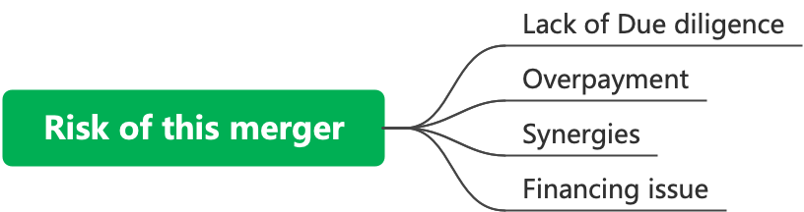
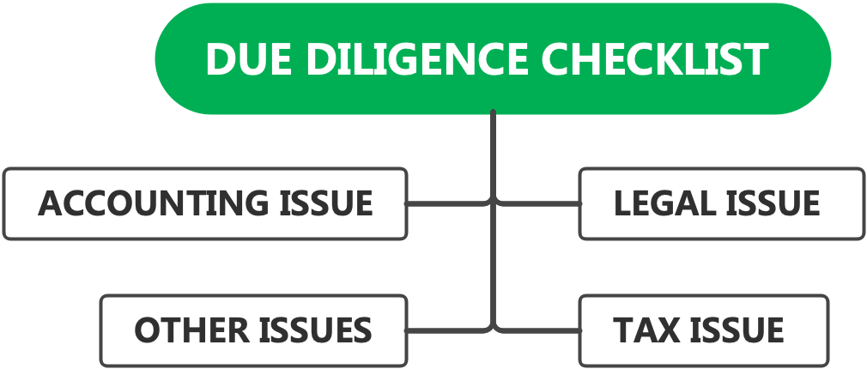

Due diligence
& Risk analysis
FCFE
Source: SEC, Refinitiv, Capital IQ, Annual Reports, Yahoo Finance, Market Watch. 21

Slide 24

FINAL DECISION
Market Prices
Earnings Cap
FCFE
FCFF
Source: SEC, Refinitiv, Capital IQ, Annual Reports, Yahoo Finance, Market Watch Units: Millions OR 1EURO 22

